Slide 1

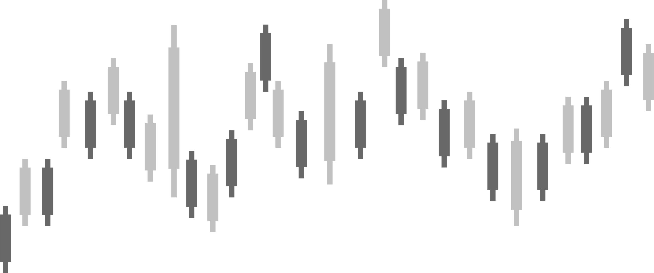

Group 5 - AI17C
Reinforcement Learning
CUTTING STOCK
Nguyen An Khuong
Lets Go!

Slide 2


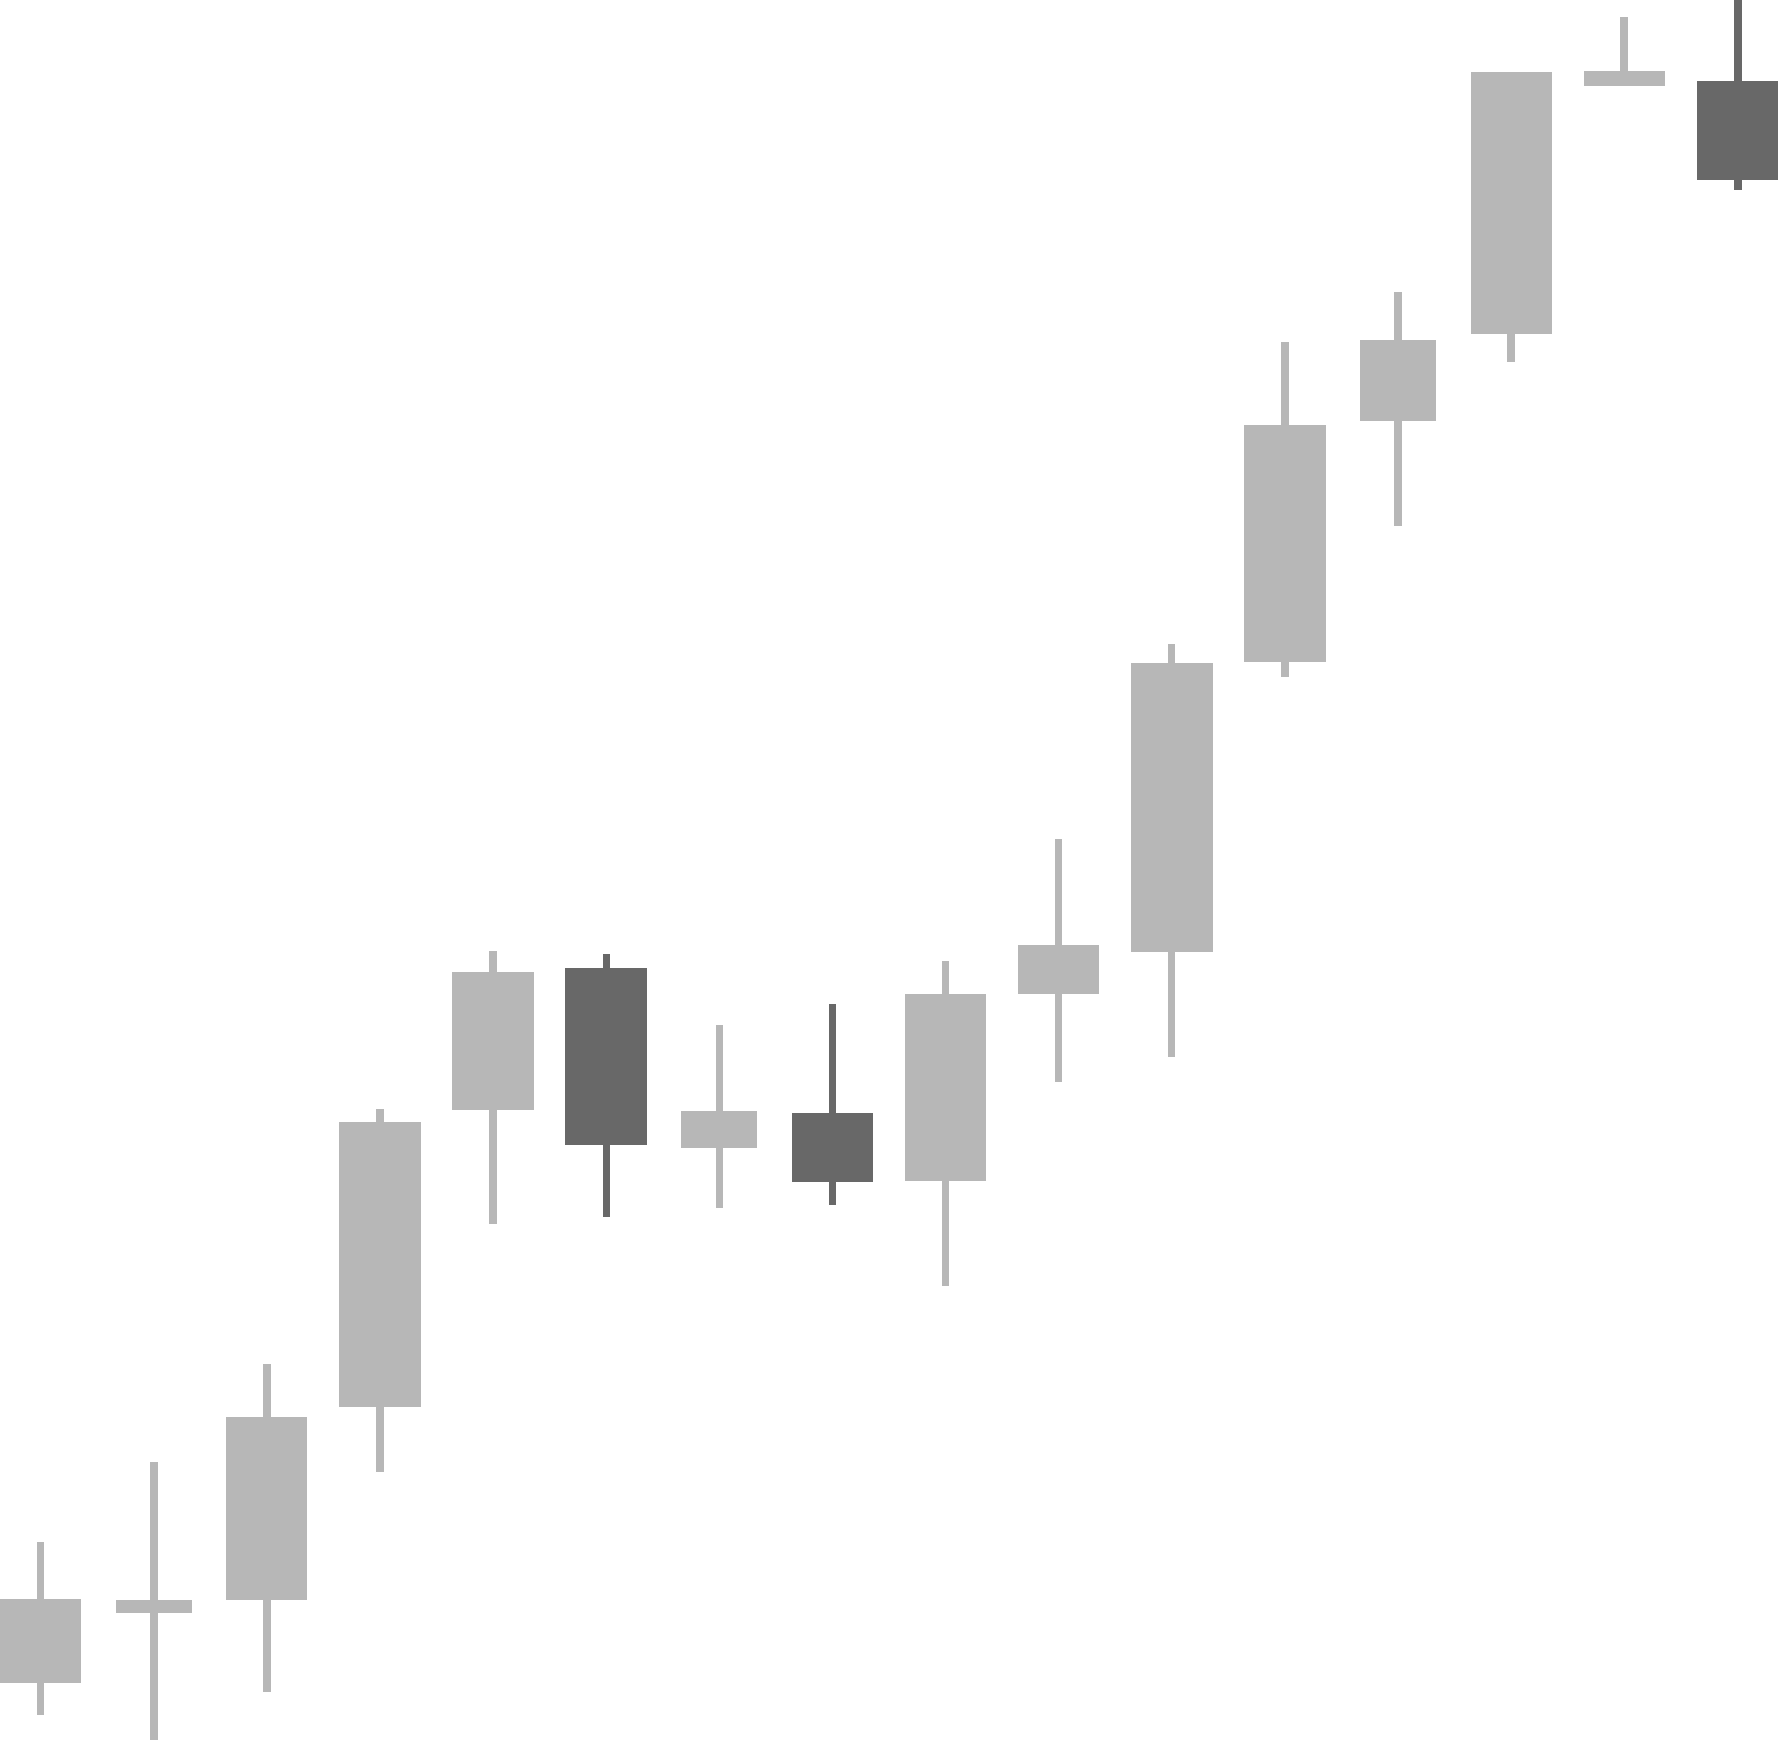



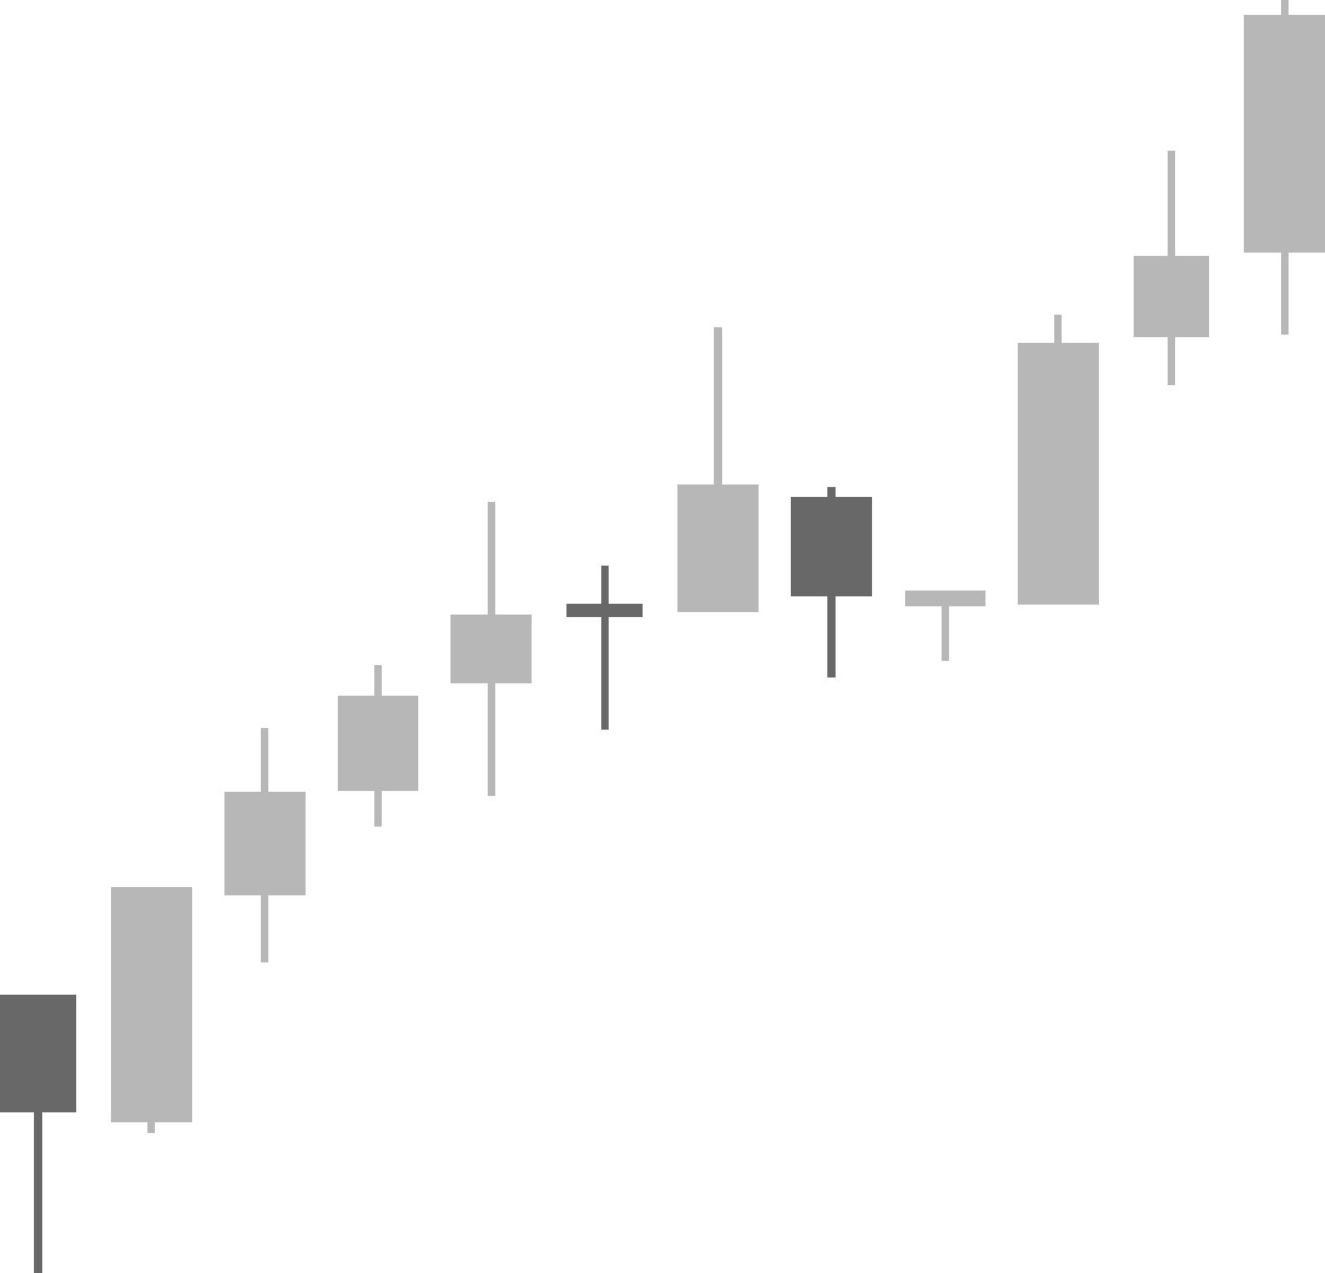

Members
Bùi Đinh Thanh Danh
Nguyễn Minh Phát
Nguyễn Trọng Nghĩa
Phạm Gia Thịnh
Chế Minh Quang

Slide 3
Content
1
Introduction
4
Environment
2
Solution
5
Algorithms
3
Tasklists
6
Demo

Slide 4


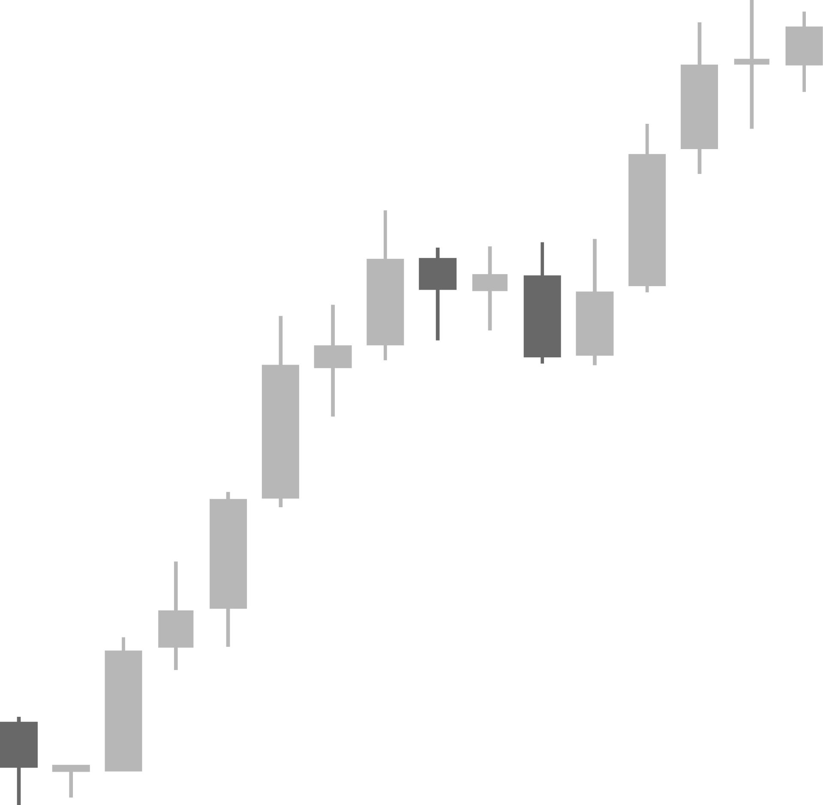
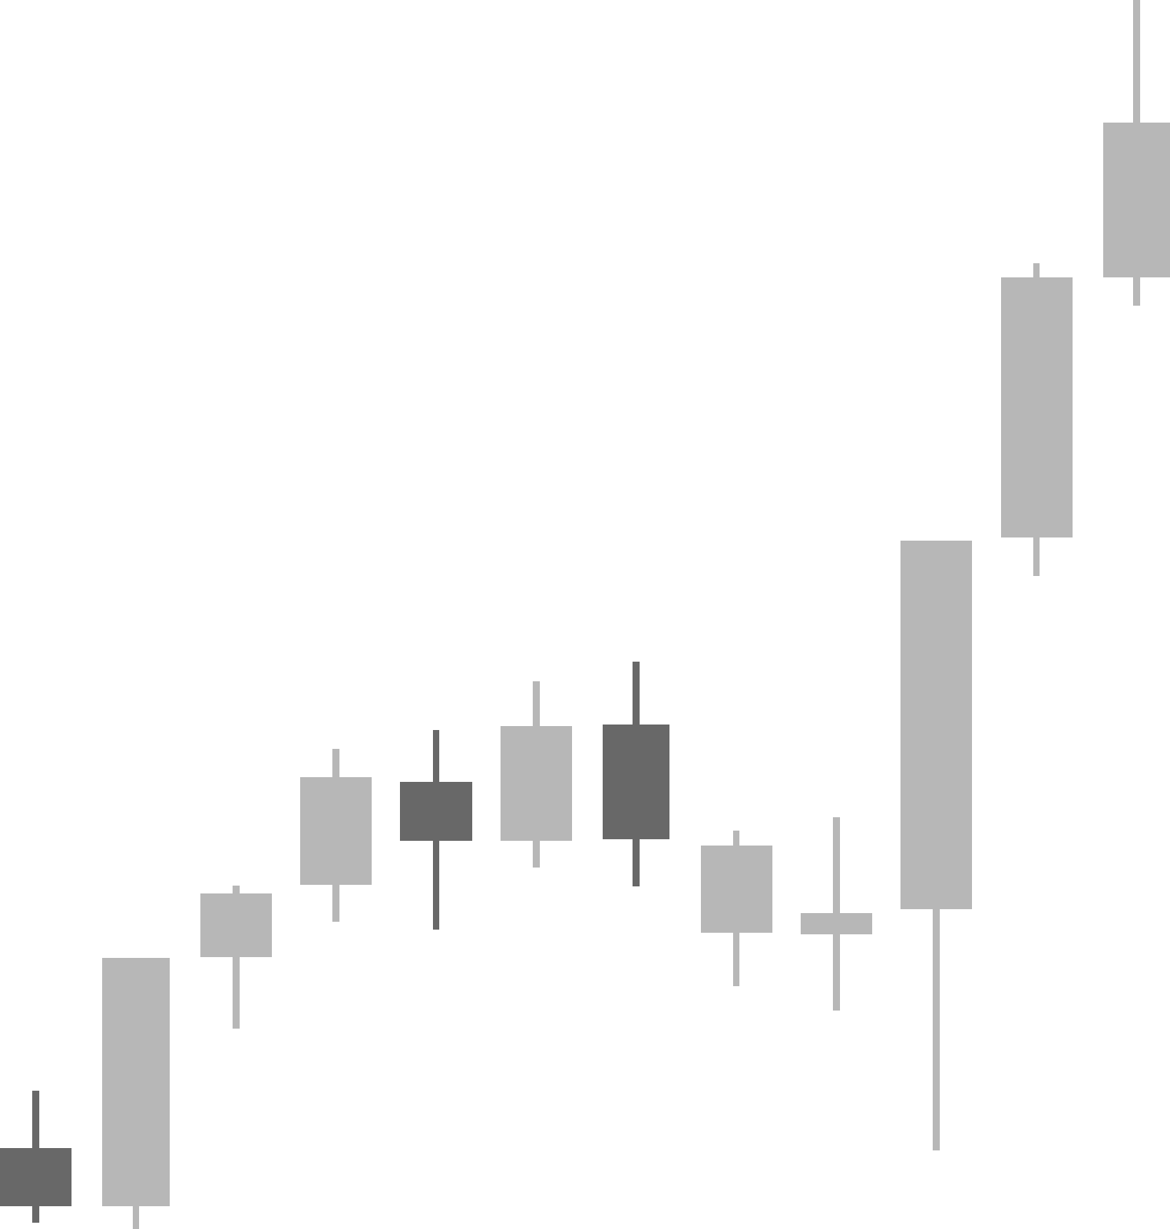
INTRODUCTION
CUTTING STOCK

Slide 5


Introduction
Source: https://baobinhduong.vn/loai-bo-lang-phi-trong-san-xuat-go-can-thiet-nhung-lung-tung--a43867.html
Source: https://laodong.vn/thi-truong/nganh-go-lao-dao-doanh-nghiep-gap-rut-tim-may-moc-tinh-gon-san-xuat-1207627.ldo

Slide 6



Introduction
In the production of flooring, large wood blanks are often cut manually or according to fixed rules.
The non-optimal arrangement of the cut pieces leads to significant material waste (the residual cannot be reused).
=>> This causes increased production costs, affecting price and sustainability.

Slide 7
2. SOLUTION
CUTTING STOCK

Slide 8



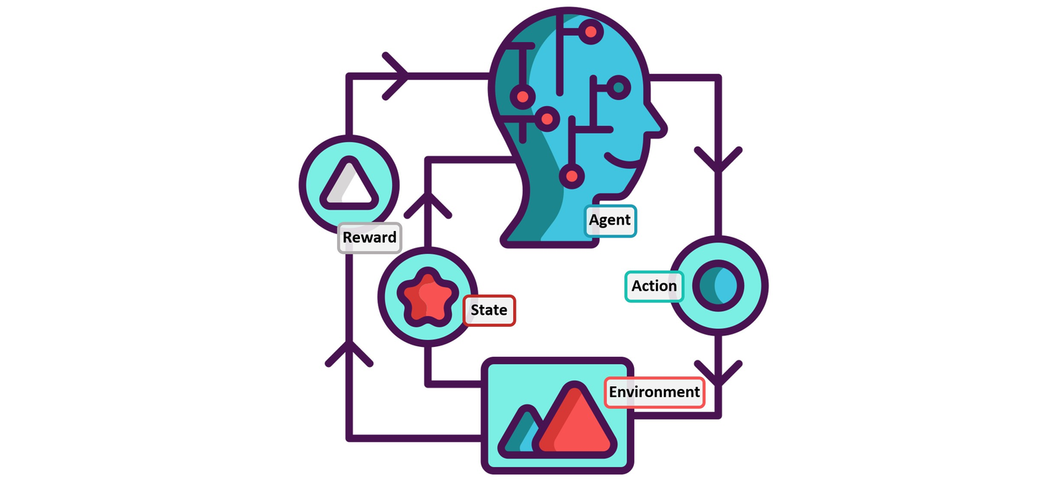


2. Solution
Limitations of traditional methods:
Cutting according to fixed rules
→ Not flexible, easy to create residuals that cannot be reused.
Manual sorting
→ Dependent on experience, inconsistent, difficult to expand.
Requirements:
Need a solution that can learn from experience.
Need the ability to make decisions according to action sequences.
Need to adapt flexibly to input data.

Slide 9

2. Solution
Reinforcement Learning in the Cutting Stock problem of cutting wood flooring:
Learning from experience:
Agent interacts with the wood cutting environment.
Learning through "trial - error - improvement".
Optimizing the excess wood area and the number of blanks used.
Decision making according to the action chain:
RL optimizes the overall cutting action chain.
Considering long-term benefits, accepting short-term sacrifices.
Efficient when cutting large, multi-sized blanks.

Slide 10
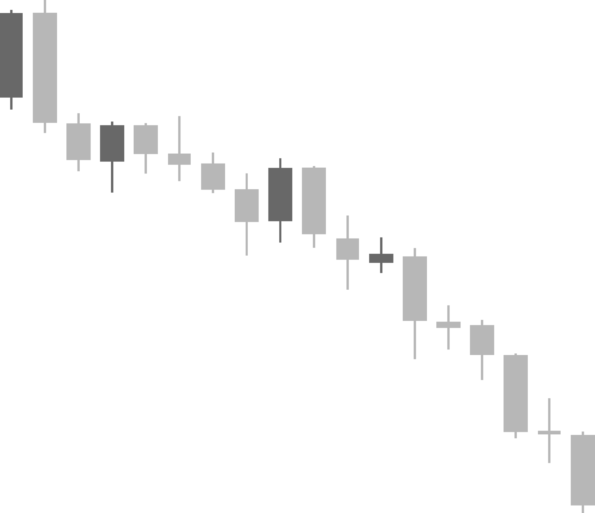
2. Solution
Datasets
Data Structure:
Number of columns: 4 columns (batch_id, type, width, height)
Number of rows: 675 rows
Data type: 2 types (stock, product)
Stocks
Average size: 76.7 × 81.5 (width × height)
Smallest size: 15 × 15
Largest size: 150 × 150
Products
Average size: 24.8 × 25.0 (width × height)
Minimum size: 15 × 15
Large size: 35 × 35

Slide 11
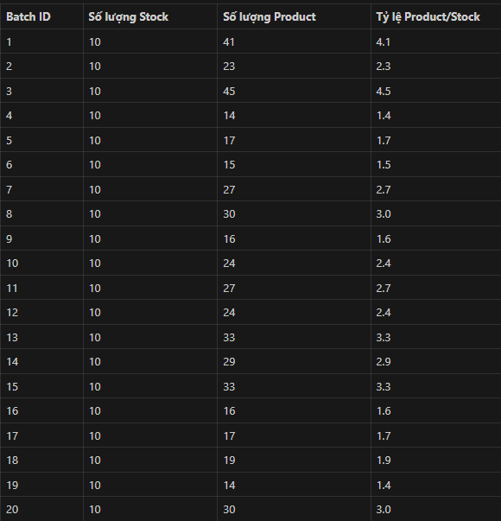
2. Solution
Datasets
Total Stocks: 200 (10 stocks/batch × 20 batches)
Total Products: 494
Average Product/Stock Ratio: 2.47

Slide 12
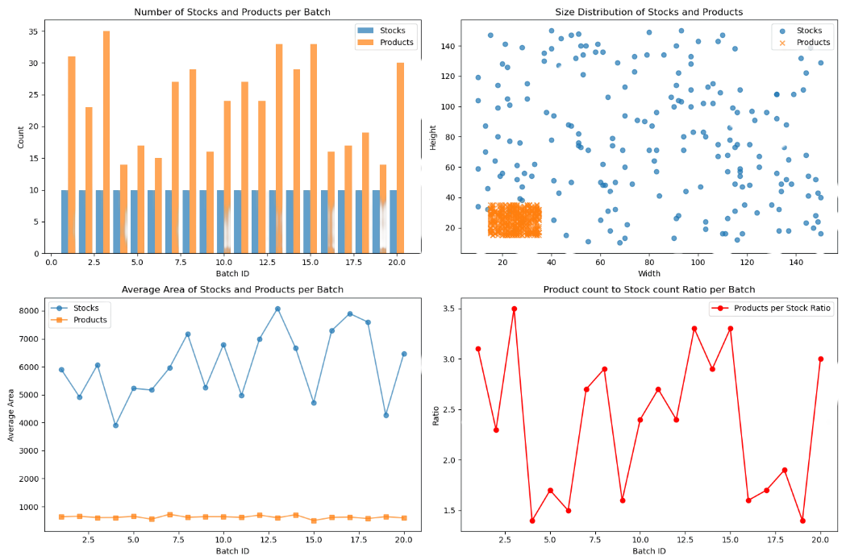
2. Solution

Slide 13
3. TASKLISTS
CUTTING STOCK

Slide 14
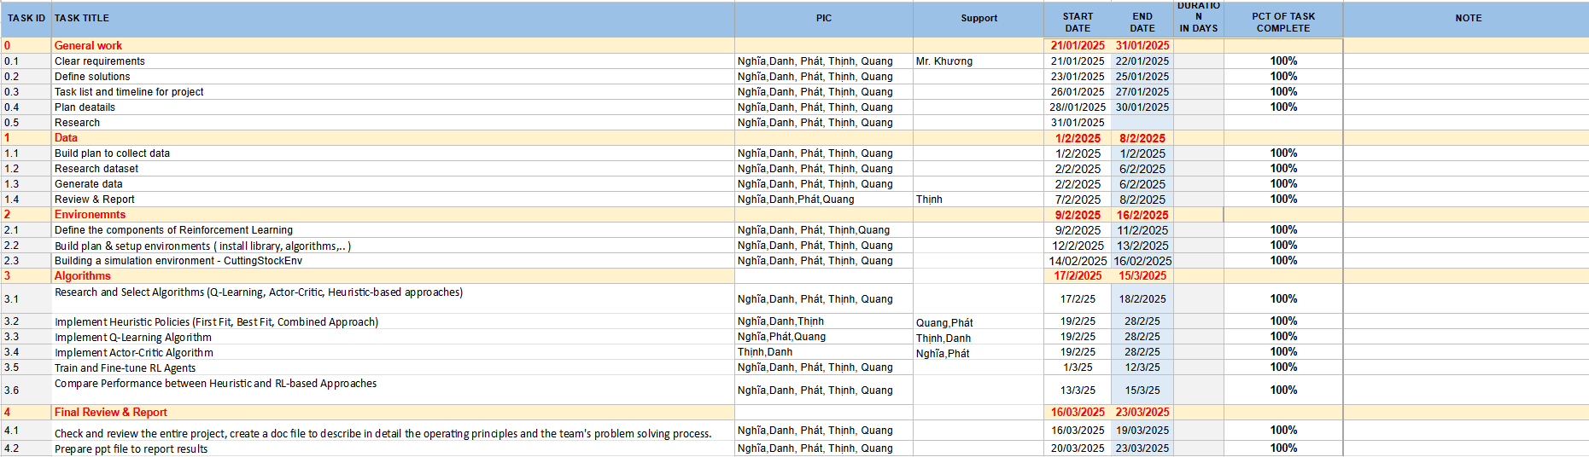
3. Tasklists

Slide 15
4. ENVIRONMENT
CUTTING STOCK

Slide 16




4. Environment
Constraint handling
Each product must be placed in the available space only
Product must be completely contained within the material sheet
Only cut products that are listed and have quantity left
P1
Sparse reward environment
+1 only if all products have been cut
0 otherwise
P2
P3
P4
P5

Slide 17

4. Environment
Reset
Stocks: Large wooden boards with random sizes from min_w x min_h to max_w x max_h.
-2: Area outside the actual size of stocks
-1: Empty area, product can be placed
≥0: Index of the product has been placed (will be updated in the step() method)
Products: Each product is a dictionary with 2 information:
size: Size (width, height) of the product
quantity: Number of products to cut

Slide 18


4. Environment
Step
Extract information from actions (stock_idx, size, position).
Find the right product from the product inventory
Processing placing the product on the material sheet ( Make sure the product does not exceed the plate size.)
Check end status and calculate rewards : Terminated = True, Rewards = 1

Slide 19
4. Environment
get_info
Provide metrics to evaluate the effectiveness of the solution
Measures the ratio of material panels used to total panels
Filled_ratio = Used stock / Total stock
Measure the percentage of empty (wasted) area on used material panels
Trim_loss = Number of Empty Cells / Total Valid Cells

Slide 20
5. Algorithms
CUTTING STOCK

Slide 21
Heuristic Algorithm
Heuristic is an approximate algorithm, used to solve complex problems quickly without finding the absolute optimal solution.
✅ Goal:
Find a “good enough” solution instead of “best”.
Save computation time, especially such as Cutting Stock, Packing, Scheduling...
Heuristic in 2D Cutting-Stock Problem
Cut rectangular products (products) from material sheets (stock sheets) so that:
Meet enough product demand
Reduce material waste
Optimize the amount of stock used

Slide 22
Heuristic Algorithm
First-Fit Algorithm
Browse each product (In descending order of size – from largest to smallest)
🔄 How it works:
For each product:
Browse the existing stocks, in order of priority
Within each stock:
Browse valid empty positions in order from (0,0) → right → down
As soon as you find a position with enough space, place the product there
Stop browsing → move to the next product
If there is no stock with enough space, open a new stock and place the product at position (0, 0)

Slide 23
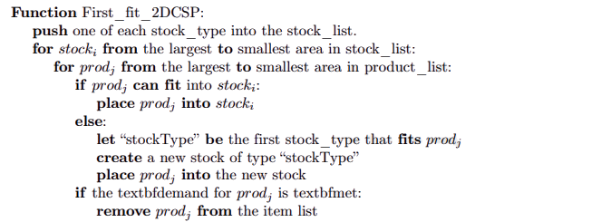

Heuristic Algorithm
First-Fit Algorithm
Source: Link

Slide 24
Heuristic Algorithm
Best-Fit Algorithm
Place the product in the stock that has the least amount of excess after placing it.
🔄 How it works:
Browse each product.
For each stock: Find all possible locations.
Estimate the excess area if placed.
Choose the best location (with the least excess) to place the product.
If there is no suitable stock, create a new stock.
⚡ Features:
The solution quality is better than First-Fit.
Takes more time to calculate.
Suitable when material optimization is needed.

Slide 25
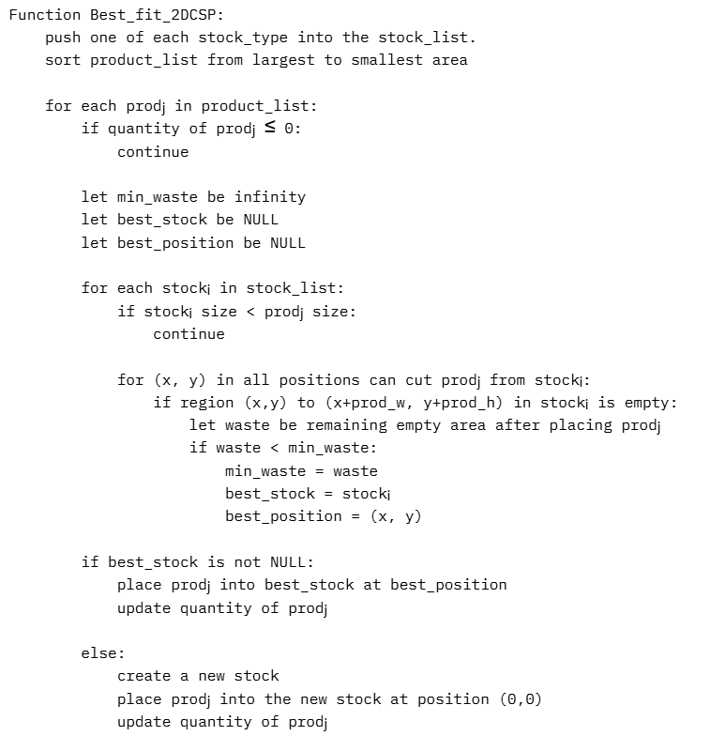
Heuristic Algorithm
Best-Fit Algorithm

Slide 26
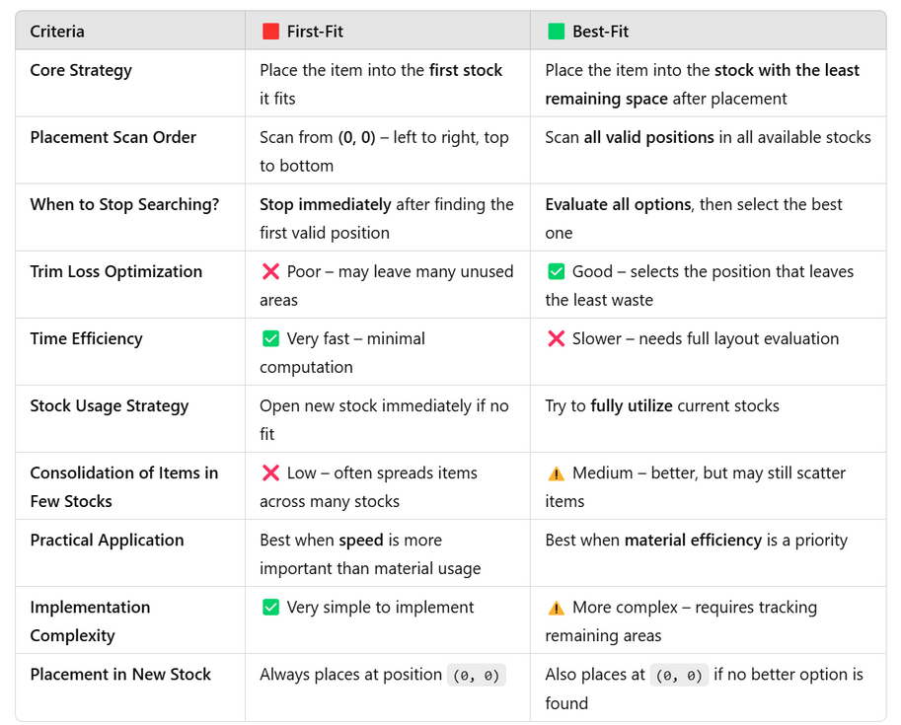
Heuristic Algorithm
Comparison : First-Fit vs Best-Fit

Slide 27
Heuristic Algorithm
Combination Algorithm
Combine First-Fit + Best-Fit to achieve both efficiency and speed.
🔄 How it works:
Phase 1: First-Fit Placement – ​​quickly place all products.
Phase 2: Best-Fit Refinement – ​​optimize placement to reduce waste.
Phase 3: Stock Merging (if applicable) – merge smaller stocks into larger stocks to reduce total stock.
🔥 Goal:
Keep the same good time performance as First-Fit
But still achieve the same material efficiency as Best-Fit
Optimize both quality and speed → suitable for practical industrial applications.

Slide 28
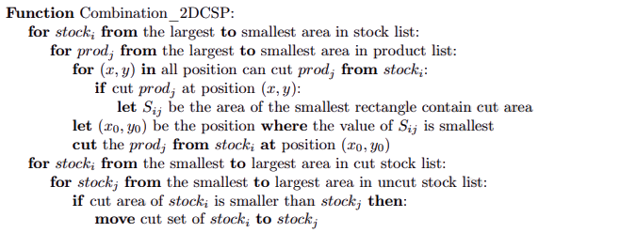
Heuristic Algorithm
Combination Algorithm
Source: Link

Slide 29
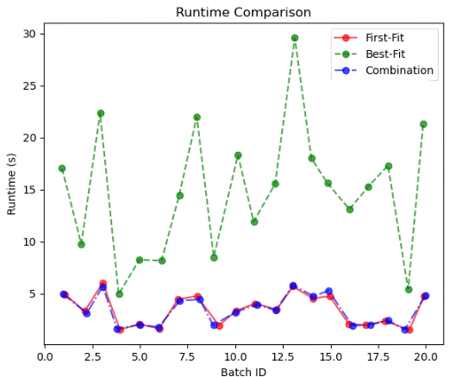
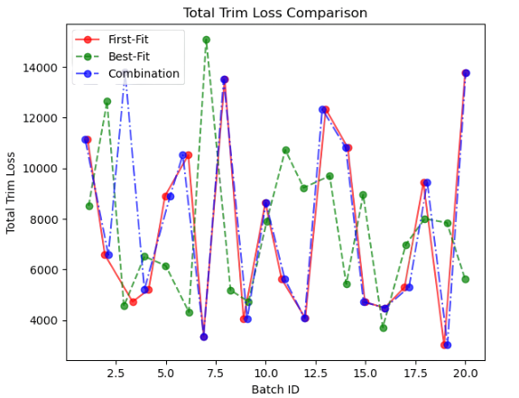
Heuristic Algorithm

Slide 30
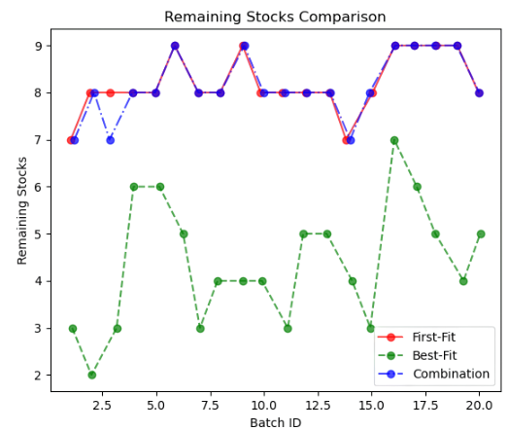
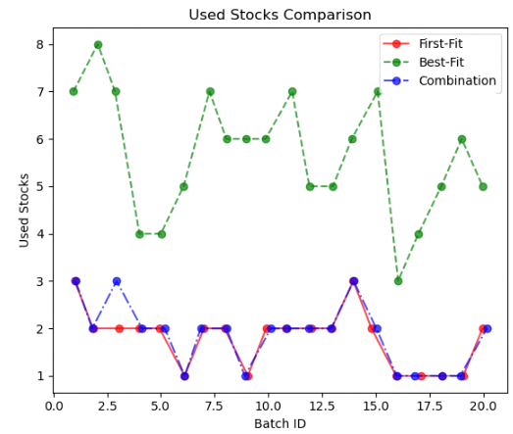
Heuristic Algorithm

Slide 31
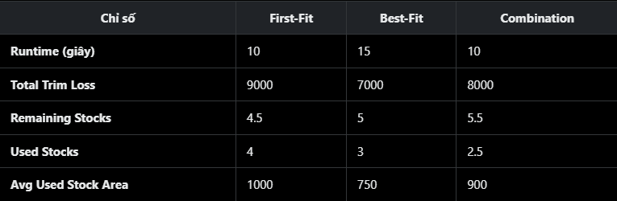
Heuristic Algorithm
Combination: Best in used stocks (Used Stocks: 2.5, Remaining Stocks: 5.5), fast run time (10 seconds), but not lowest Trim Loss (8000).
Best-Fit: Best in Trim Loss (7000) and Average Used Stock Area (750), but slower (15 seconds).
First-Fit: Fast (10 seconds), but worst in Trim Loss (9000), Used Stocks (4), and Average Used Stock Area (1000).

Slide 32
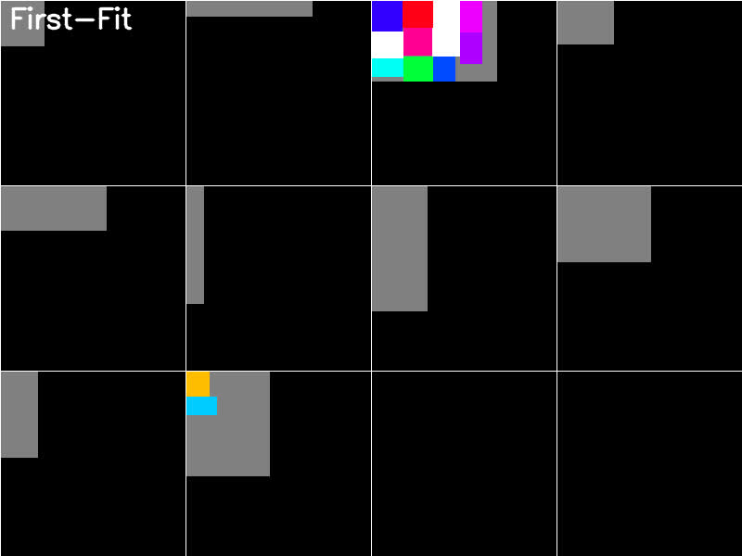
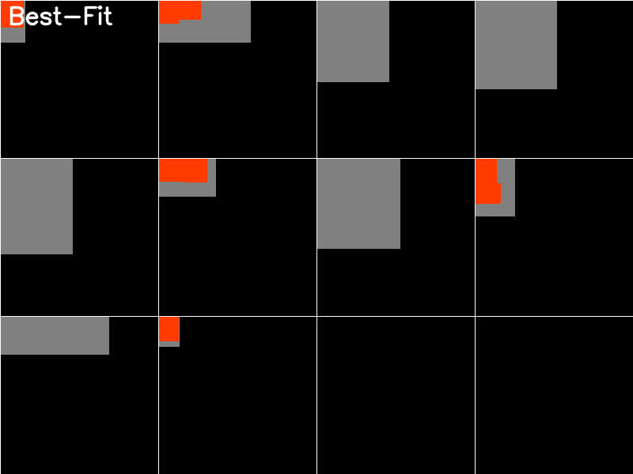
Heuristic Algorithm
Batch 3
Batch 10

Slide 33
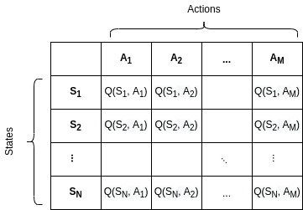
Q-Learning Algorithm
How Q learning works?
1. Initialize environment and Q-table
Q-table
create environment
The environment is created using the CuttingStockEnv class with a list of stocks and products:
Stocks: Raw material sheets with maximum size of (120,120)
Products: Cut products with maximum size of (120,120)

Slide 34
Q-Learning Algorithm
How Q learning works?
2. Initialize environment and Q-table
Convert the state from the environment into an integer to store in the Q-table. In this problem:
The state is calculated based on the empty_space in stocks and the number of remaining products (remaining_products):

Slide 35
Q-Learning Algorithm
How Q learning works?
3. Action Selection
Use epsilon-greedy strategy:
If random < ε: Choose random action (random.randint(0, action_size-1)).
Otherwise: Choose action with highest Q value (np.argmax(Q_table[state])).
Then convert action from Q-table into real action in environment, for example: which stock to choose, which product to cut, at which position.
=> Convert action to environment
=> Take action and get feedback

Slide 36
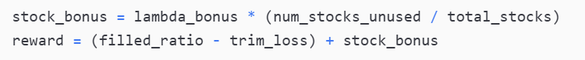
Q-Learning Algorithm
How Q learning works?
4. Reward Calculation
Bonus calculation based on:
filled_ratio: Material used.
trim_loss: Material discarded.
stock_bonus: Based on unused stock:

Slide 37
Q-Learning Algorithm
How Q learning works?
5. Update Q-table
After each step, the Q value is updated using the Bellman formula:
Q_table[state, action] = (1 - alpha) * Q_table[state, action] + alpha * (reward + gamma * np.max(Q_table[next_state]))
This formula balances between maintaining previous experience and learning from new feedback, thereby gradually converging on the optimal policy for the agent during training.
=> Repeat and decrease epsilon

Slide 38
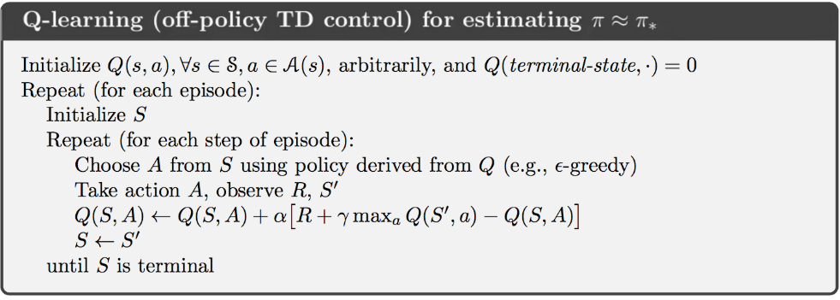
Q-Learning Algorithm
Q learning Algorithm Pseudocode

Slide 39
Q-Learning Algorithm
Datasets
stocks
(50, 50), (60, 40), (70, 50), (80, 60), (90, 70),
(100, 50), (110, 60), (120, 80), (130, 90), (140, 100),
(150, 120), (160, 130), (170, 140), (180, 150), (200, 200)
products
(10, 5), (15, 10), (20, 10), (25, 15), (30, 20),
(35, 20), (40, 30), (45, 25), (50, 30), (55, 35),
(20, 15), (25, 10), (30, 15), (35, 20), (40, 25),
(45, 30), (50, 35), (55, 40), (60, 45), (65, 50),
(70, 30), (75, 40), (80, 50), (85, 55), (90, 60),
(15, 10), (20, 15), (25, 20), (30, 25), (35, 30)

Slide 40
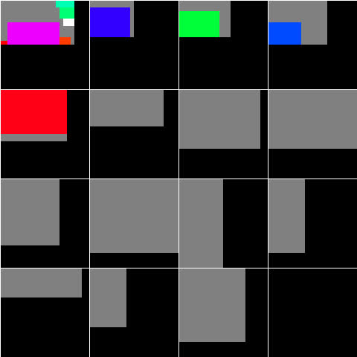
Q-Learning Algorithm
Evaluation

Slide 41
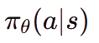
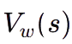
Actor-Critic Algorithms
a) What is Actor-Critic?
Actor-Critic is a hybrid reinforcement learning (RL) approach that combines:
Policy-based RL (Actor): Learns the optimal policy directly.
Value-based RL (Critic): Evaluates actions for more stable learning.
Actor ( ):
Represents the policy model, selecting actions.
Updated using the policy gradient method.
Critic ( ):
Estimates the value function of a state.
Helps stabilize learning by providing feedback to Actor.

Slide 42
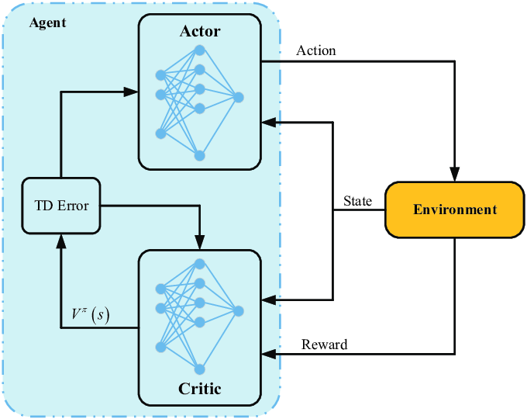
Actor-Critic Algorithms
b) Architecture of Actor-Critic
Figure 5 - available via license: Hybrid NOMA/OMA-Based Dynamic Power Allocation Scheme Using Deep Reinforcement Learning in 5G Networks
( https://www.mdpi.com/2076-3417/10/12/4236)

Slide 43
Actor-Critic Algorithms
c) Hyperparameters and Workflow
Hyperparameters
GAMMA = 0.99
LR = 0.001
MAX_EPISODES = 1000
MAX_STEPS = 200
MAX_W = 100
MAX_H = 100
MAX_PRODUCTS = 100
EPSILON_START = 0.5
EPSILON_END = 0.01
EPSILON_DECAY = 0.995

Slide 44
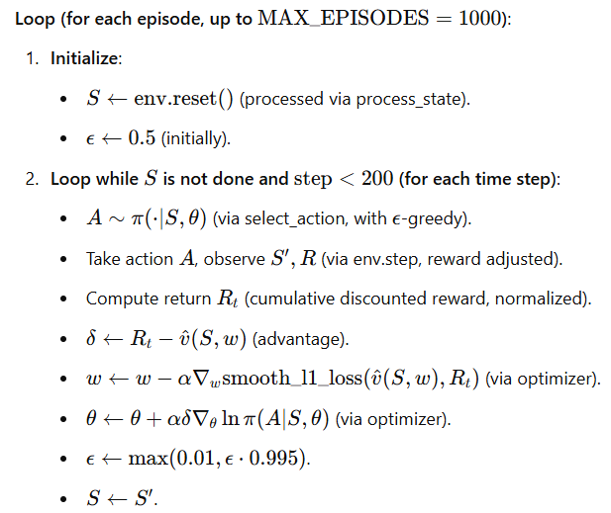
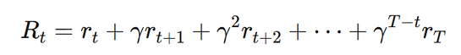
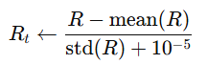
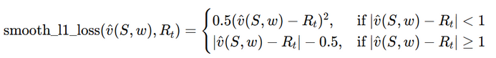
Actor-Critic Algorithms
c) Hyperparameters and Workflow
With:
Calculate return
Normalize reward value
Smooth L1 Loss

Slide 45
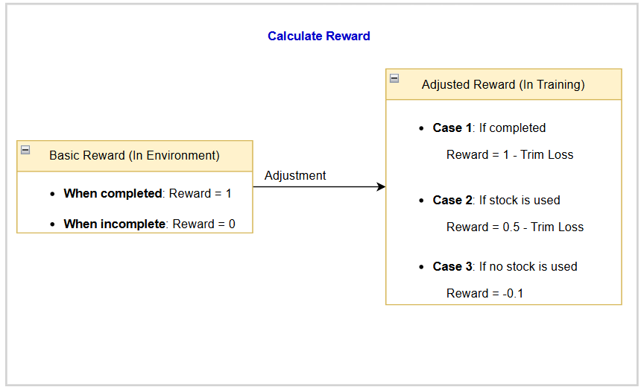
Actor-Critic Algorithms
c) Hyperparameters and Workflow

Slide 46
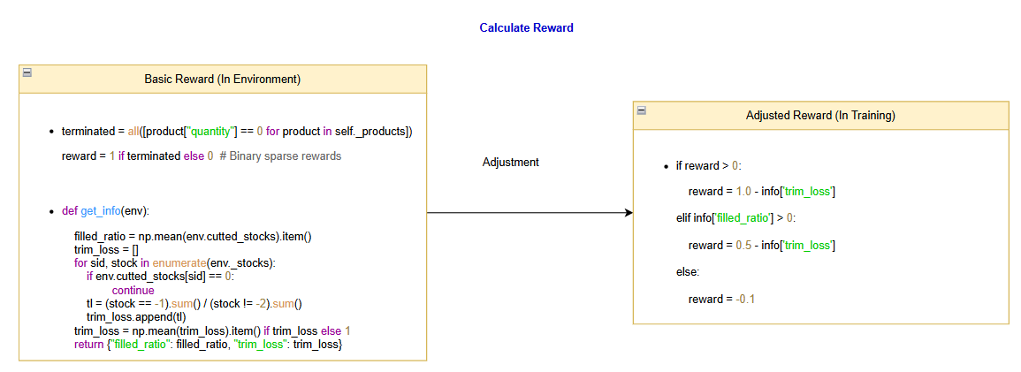
Actor-Critic Algorithms
c) Hyperparameters and Workflow

Slide 47
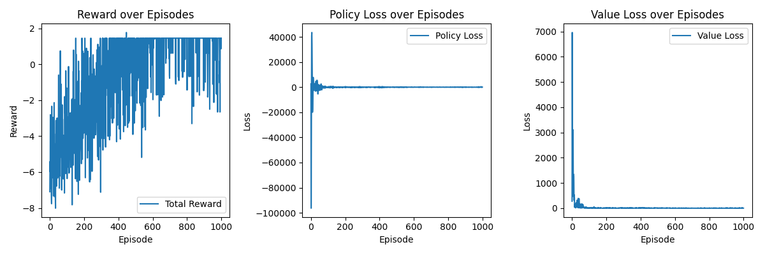
Actor-Critic Algorithms
d)Evaluate
Evaluate: Train with 10 stocks and 31 products

Slide 48
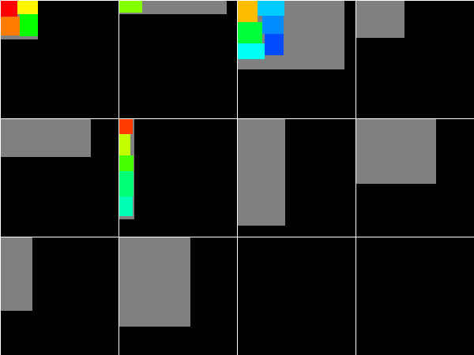
Actor-Critic Algorithms
d) Evaluate
Evaluate: Train with 10 stocks and 31 products

Slide 49
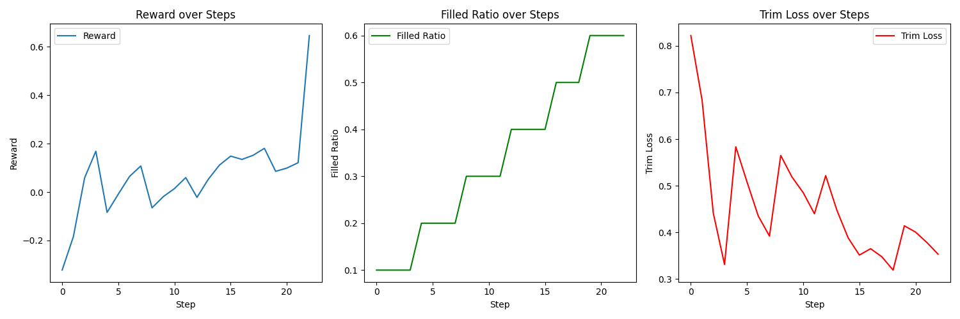
Actor-Critic Algorithms
d) Evaluate
Evaluate: Test with 10 stocks and 23 products

Slide 50
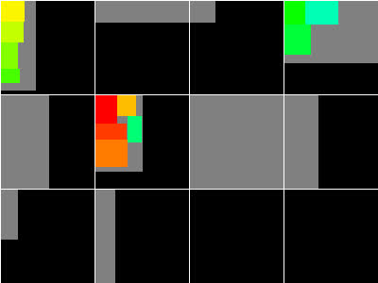
Actor-Critic Algorithms
d) Evaluate
Evaluate: Test with 10 stocks and 23 products

Slide 51
DEMO
CUTTING STOCK

Slide 52
Thank You

